Slide 1
IP
  Internet Protocol…
  TCP, UDP, ICMP are transmitted as IP DATAGRAMS
  Best effort
  Connectionless datagram delivery

Slide 2
IP
Internet Protocol (IP)
  Primarily transmits and delivers data between devices on internetworks
Each packet contains a header structure comprising a number of specialized fields
  In addition to the actual data
IPv4 and IPv6 packets differ significantly

Slide 3
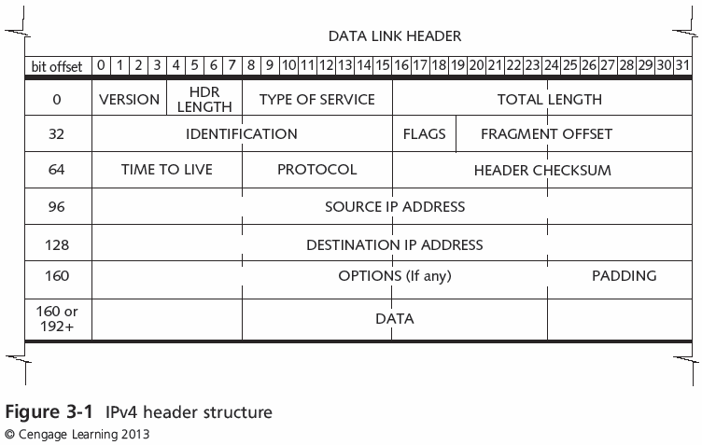
IP

Slide 4
IP
Time to live (TTL)
  Remaining distance that the packet can travel
Defined in terms of seconds
  Value is implemented as a number of hops
Typical starting TTL values are 32, 64, and 128
  Maximum TTL value is 255

Slide 5
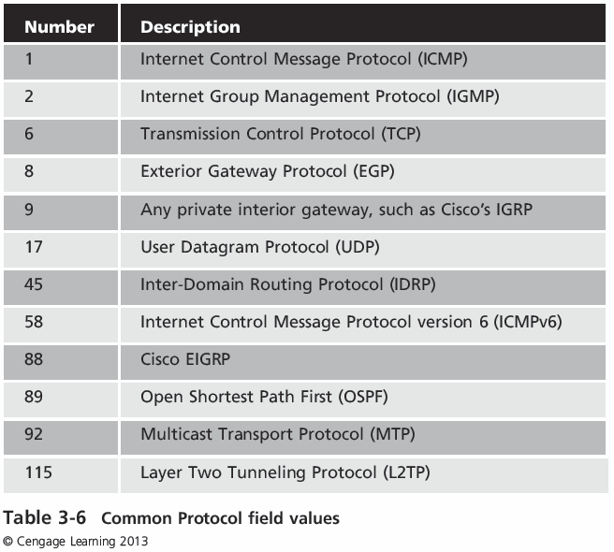
Protocol field

Slide 6
Header Checksum field
Provides error detection on the contents of the IP header only
  In addition to the data link error-detection mechanism
Required for packets that pass through routers

Slide 7
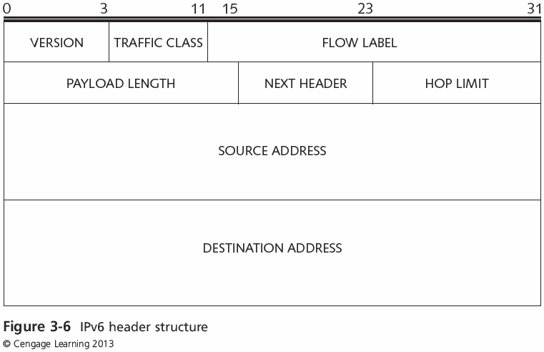
IPv6 Header structure

Slide 8
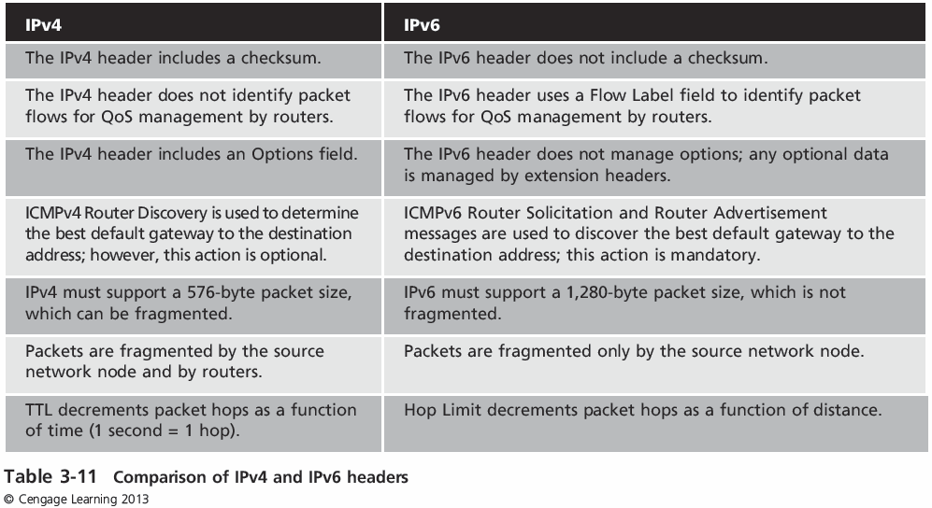
Comparing IPv4 and IPv6

